Slide 1
Statistical AI Agent for Dataset Analysis
A Parallel-Validation Statistical Analysis System
with AI-Powered Chat Interface
Lei GAO (s327756) • Lan DENG (s338219)
Notes:
Good morning, Professor. We are excited to present our project: Statistical AI Agent for Dataset Analysis.
I am Gao Lei, and I will be covering the system architecture and analysis engine. My teammate, Deng Lan, will demonstrate the AI Agent later.

Slide 2
System Architecture Overview
Data Input
→
Preprocessing
→
Parallel Analysis
Statistical Tests
Auto Gluon
↓
Shared Session State
↓
Model Training
AI Agent Chat
Notes:
Our system uses a Parallel Analysis architecture. We run statistical tests and AutoML (AutoGluon) independently, storing all results in a Shared Session State. This ensures consistent data context for both our Model Training and the AI Agent

Slide 3
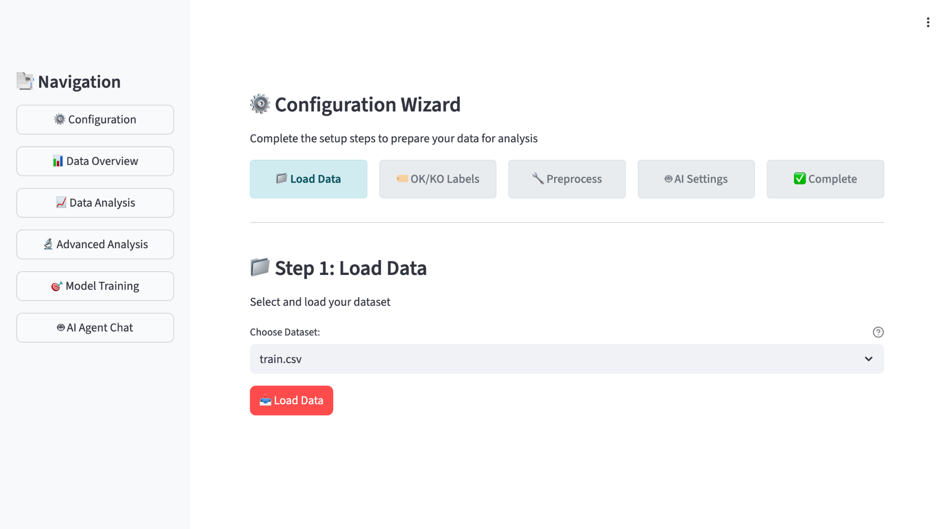
Configuration Interface
Notes:
we can see there are 6 pages in the Project, the first page is configuration. It contains 5 steps to set our project. The first step is Load Data. You should drop your dataset into the data/raw folder.
The system auto-detects all available files, so you can simply select your dataset from the dropdown and hit the Load button.
For this demonstration, I’ll be using the Titanic dataset.
It is a perfect example because it contains a mix of numerical and categorical features.

Slide 4
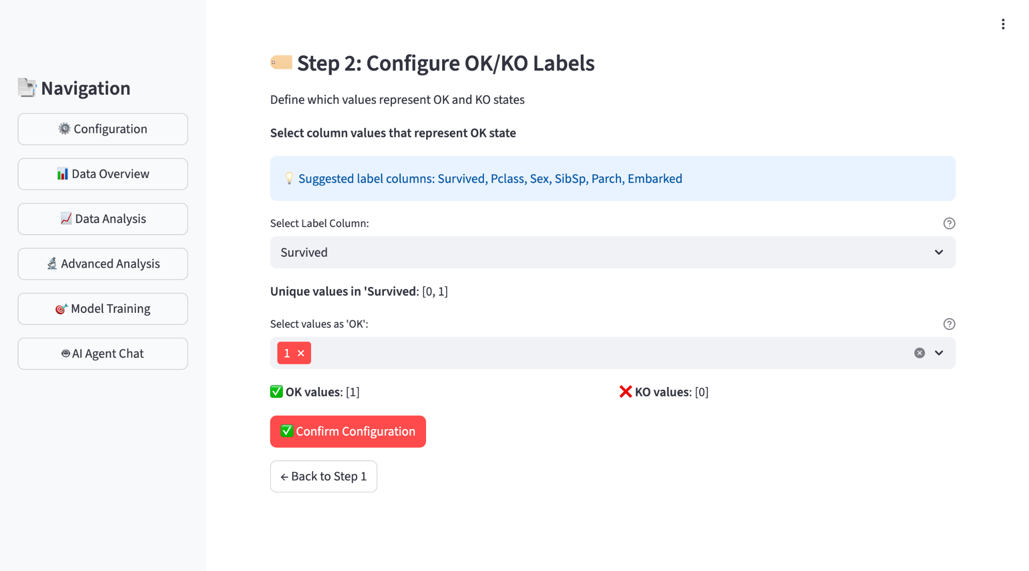
Configuration Interface
Users control all preprocessing parameters through intuitive web interface
Notes:
Next, we define our OK/KO labels
You simply select which values represent the OK state; all other values are automatically categorized as KO. This makes it perfect for transforming multi-class datasets into binary classification tasks.
The system suggests potential label columns—typically those with 2 to 10 unique values. You simply select which values represent the OK state; all other values are automatically categorized as KO. This makes it perfect for transforming multi-class datasets into binary classification tasks.

Slide 5
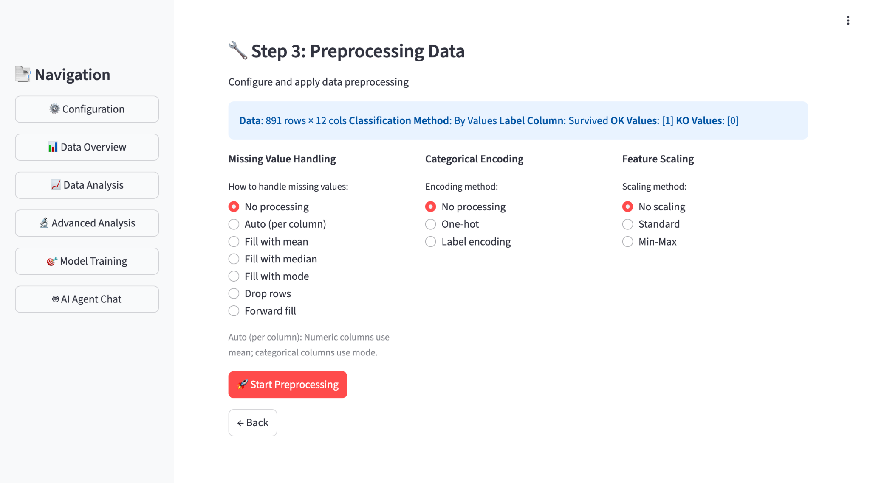
Configuration Interface
Users control all preprocessing parameters through intuitive web interface
Notes:
The step 3 is about data preprocessing.
We provide three key modules for it:
For Missing Values: We replace gaps using strategies like Mean, Median, Mode, or Forward-fill. Alternatively, we can Drop blank rows. This ensures the dataset is complete and prevents model errors during analysis.
For Categorical Encoding: We convert text into numbers using Label or One-hot encoding, making the data readable for machine learning algorithms.
For Feature Scaling: We align the data scale using Standard or Min-Max scaling.

Slide 6
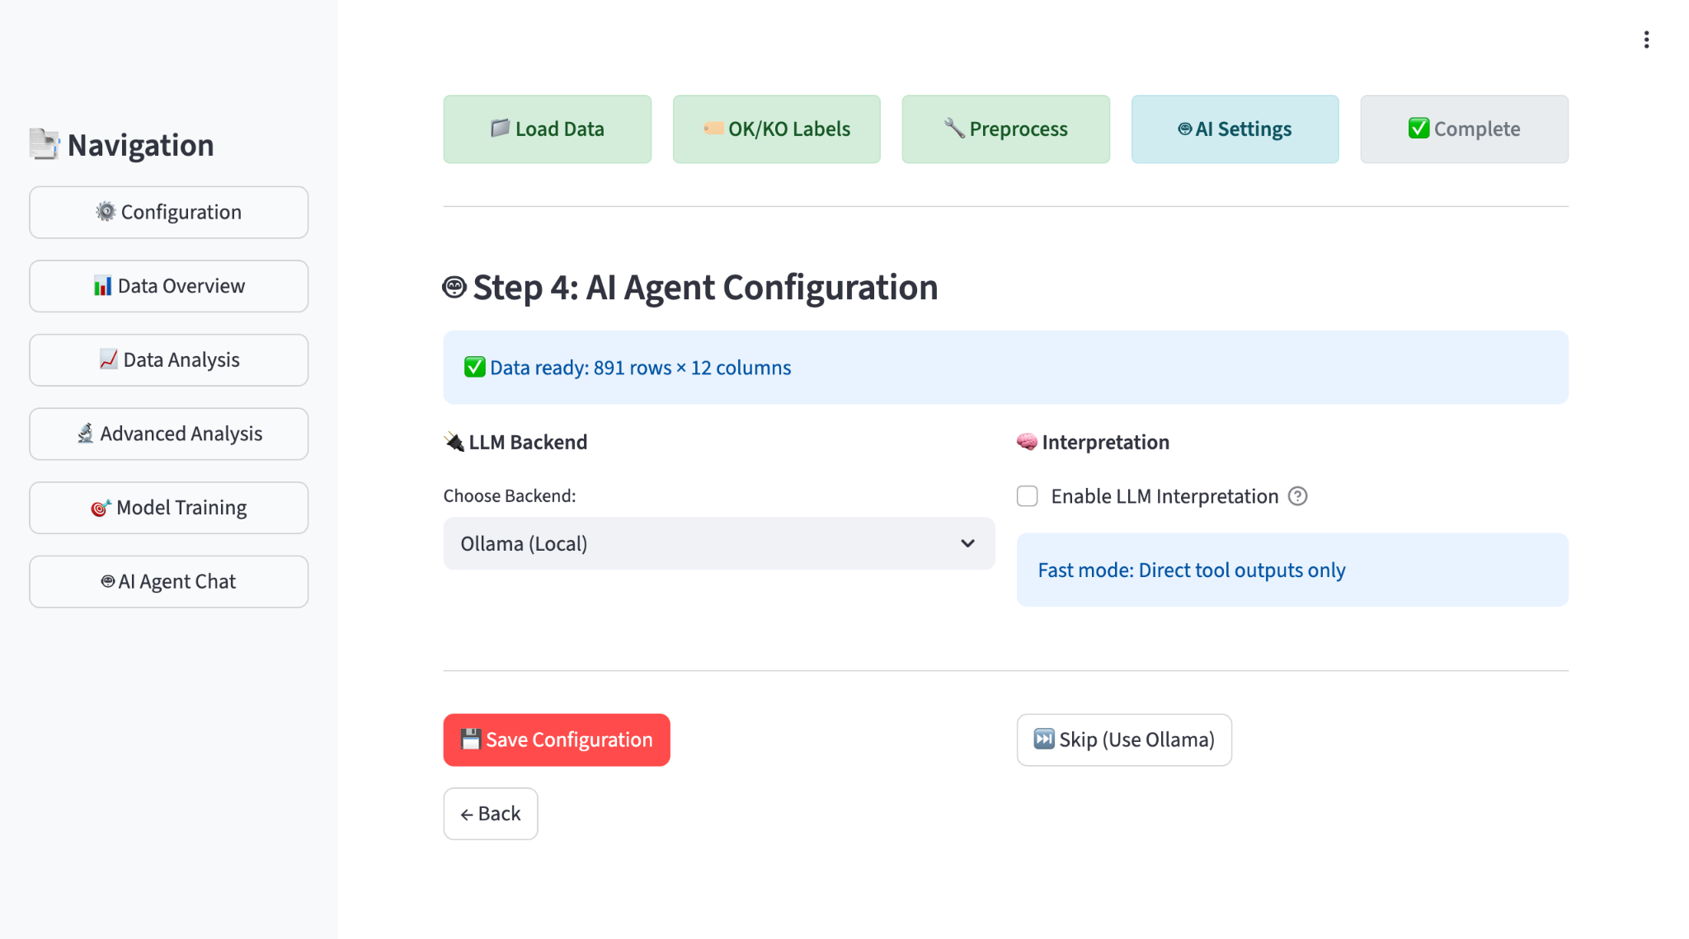
Configuration Interface
Users control all preprocessing parameters through intuitive web interface
Notes:
Step 4 is where we set the AI's configuration. We use Ollama to run LLAMA3 locally, which ensures your data privacy as it never leaves your computer. You can toggle Enable LLM interpretation on to receive expert text summaries, or keep it off for faster, direct tool outputs. Finally, hit 'Save Configuration' to move to the last step.

Slide 7
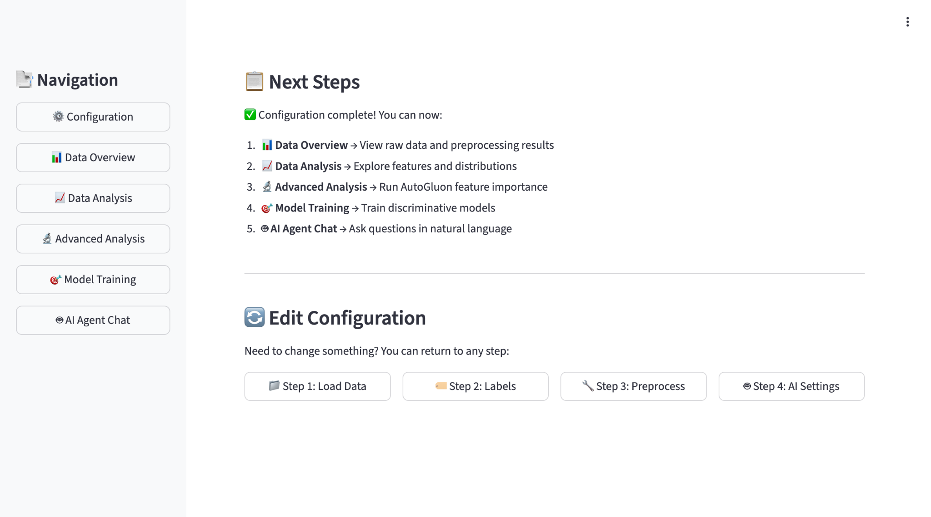
Configuration Interface
Users control all preprocessing parameters through intuitive web interface
Notes:
Finally we reach complete. it displays an introduction of what we can do next. And there are some quick-access buttons to jump back to previous step.

Slide 8
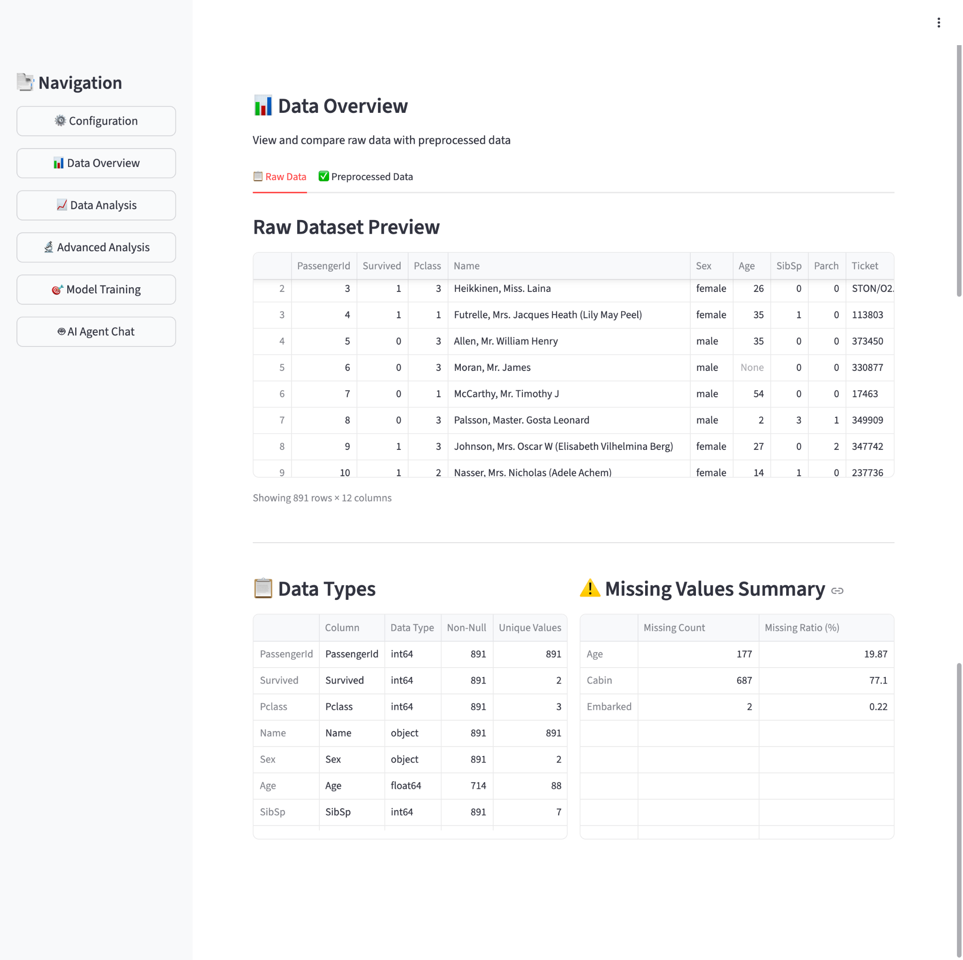
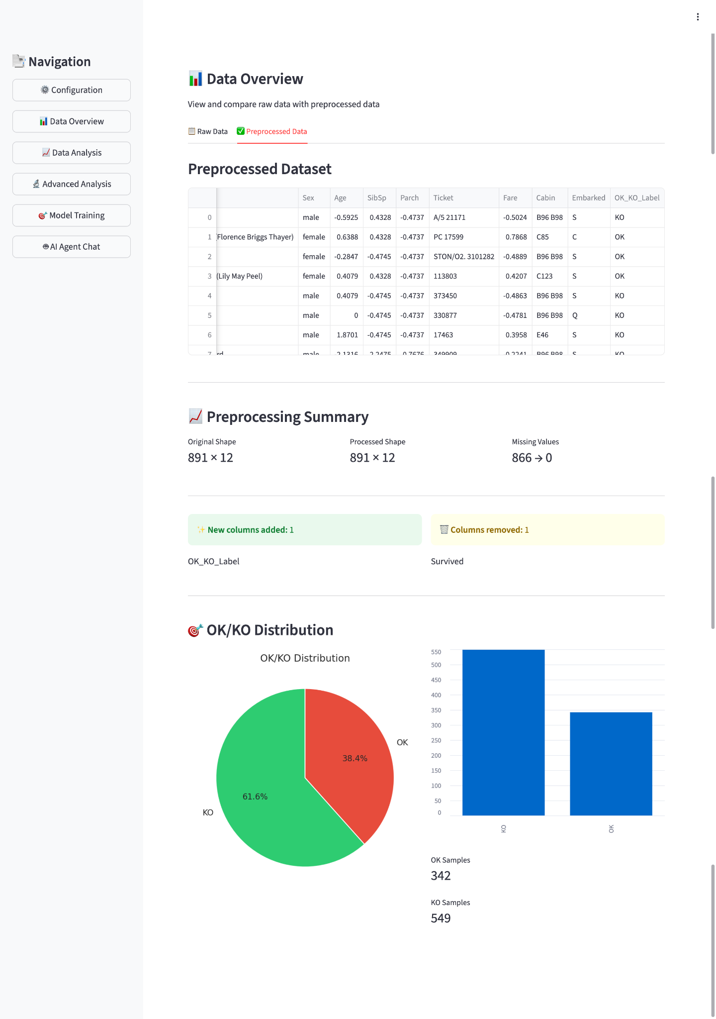
Data Overview
Dataset statistics and initial exploration
Notes:
In Data Overview, we can compare the original and processed datasets. The original view shows us data types and where values are missing. Then, in the processed view, we can see the final data shape and check the OK/KO distribution through these pie and bar charts.

Slide 9
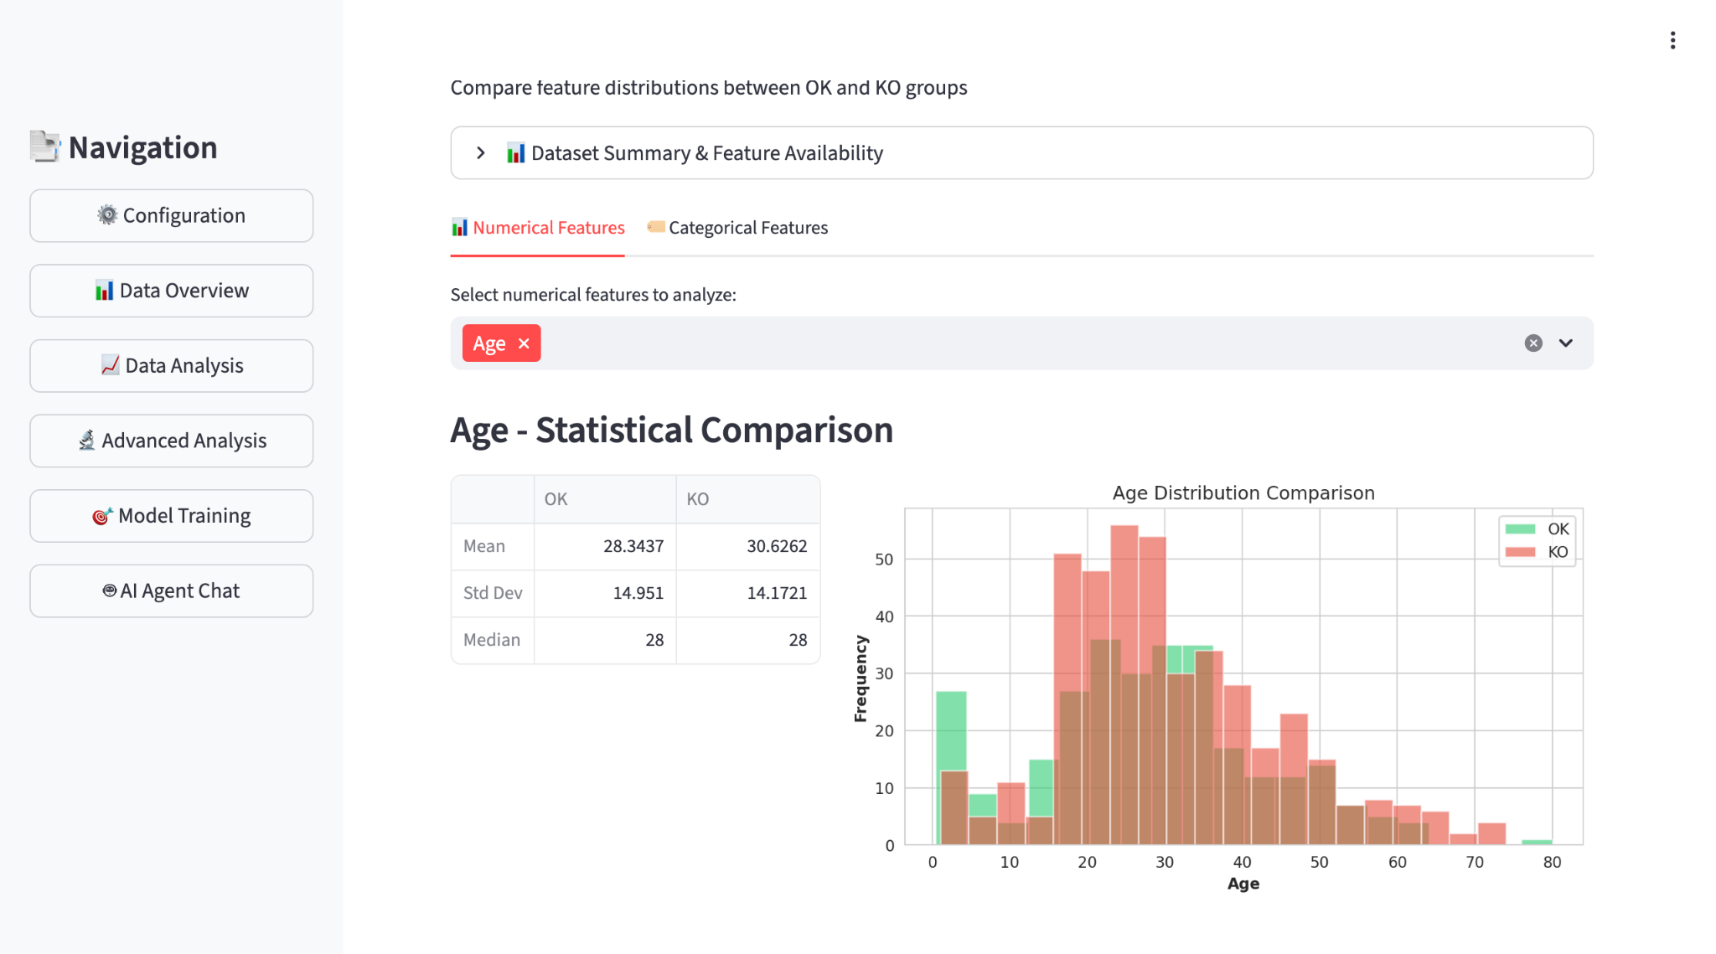
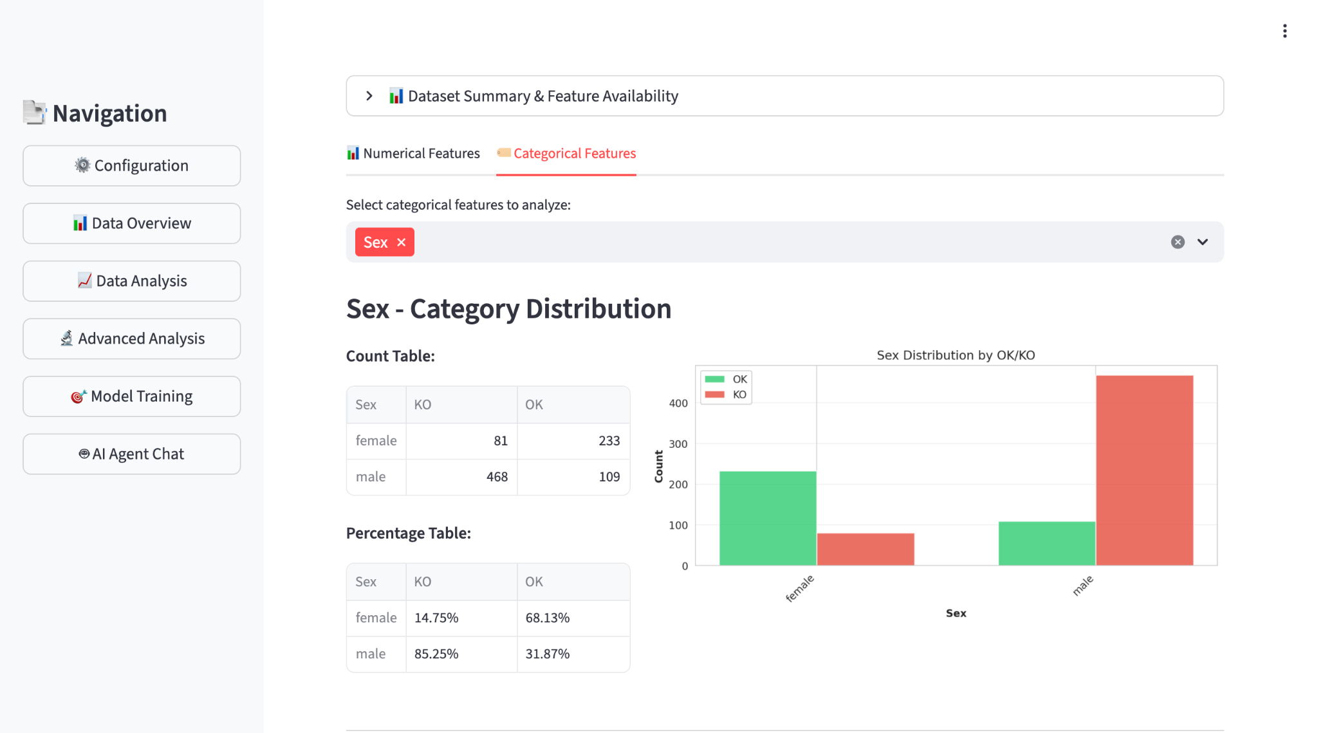
Data Analysis A
Data Analysis
Notes:
Next, It's Data Analysis. It’s a simple tool to compare each feature against our OK and KO labels. For numerical features like age, the histogram shows where the two groups overlap and where they differ. For categorical features like sex, the bar chart clearly shows that females have a much higher 'OK' rate compared to males.

Slide 10
Statistical Ranking
Numerical |  | Categorical
p_{MW} | Mann-Whitney U test p-value (reliability) | p_{chi-square} | chi-square test p-value (reliability)
Cohen's d | effect size (strength of difference) | Cramér's V | effect size (association strength)
Difference Ratio | relative magnitude (normalized by max mean)
-log₁₀(p_{MW}) * Cohen's d * Difference Ratio |  | -log₁₀(p_{chi-square}) * Cramér's V
Notes:
In the page of Advanced Analisis .For Statistical Ranking, for numerical features, we multiply these three factors: the negative log of p-value from Mann-Whitney U test, Cohen's d, and the Difference Ratio. For categorical features, we multiply the negative log of p-value from chi-square and Cramér's V. We use these composition score to rank every feature.
MW(P-value): "Tells us if the difference between the two groups is statistically real, not just random luck."
Cohen's d: "Measures the strength of the difference—basically, how big the gap is."
Difference Ratio: "Shows the relative size of the gap between the averages as a percentage."
$p_{chi-square}$ (P-value): "Confirms if the relationship between the feature and the target is statistically reliable."
Cramér's V: "Measures how strong the connection is, on a scale from 0 (no connection) to 1 (perfect connection)."
MW：A robust method that compares the rank order of data rather than raw values, ensuring reliable results even with outliers or irregular distributions.
Chi-square:Validates the statistical significance of categorical features by comparing the observed distribution against the expected one.The 'Expected' distribution comes from the Null Hypothesis.
It represents the theoretical average: Specifically, what the survival numbers would look like if this feature (e.g., Sex) had zero effect.
We calculate it by applying the overall survival rate to each specific group.
Composite Scoring Logic:
Goal: A high score requires high Significance, large Effect Size, and substantial Relative Change simultaneously.
Balance: We avoid ranking solely by P-value or Effect Size to ensure both statistical rigor and practical impact.
Numerical Features: We include difference_ratio to supplement Cohen's d. This captures the intuitive shift in means, which standard deviation alone might miss.
Categorical Features: We rely on Cramér's V, which already serves as a standardized measure of association strength. Since difference_ratio is undefined for categories (no means), the formula is simply Significance × Cramér's V.

Slide 11
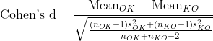
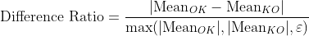

Slide 12
ML Ranking
AutoGluon Configuration & Logic
Training Outputs
AutoGluon Tabular Predictor
Leaderboard
Full model ranking
Metric: Accuracy | Preset: Medium | Time Limit = 120s
Data Splitting (Auto)
Best Model
WeightedEnsemble_L2
Train/Validation split by Auto Gluon
Ensemble Learning (Stacking)
Validation Accuracy
0.8771
Stack Level 2; base models + WeightedEnsemble_L2
Permutation Importance
Training Time
≤120s total time
Permutation Importance
Feature importance via shuffling
Feature importance via shuffling
Notes:
In ML Ranking.We use TabularPredictor with Accuracy as the evaluation metric, the medium_quality preset, and a total training time limit of 120 seconds.
AutoGluon automatically splits the data into training and validation sets;
During training, multiple base models are tried in parallel and then stacked into a two-level ensemble (Stack Level 2), producing the final WeightedEnsemble_L2.
Feature importance is computed via permutation: each feature is shuffled to observe the drop in accuracy, producing a ranked list.
The right panel shows the training outputs: full model leaderboard, best model name, validation accuracy, and the overall time limit.

Slide 13
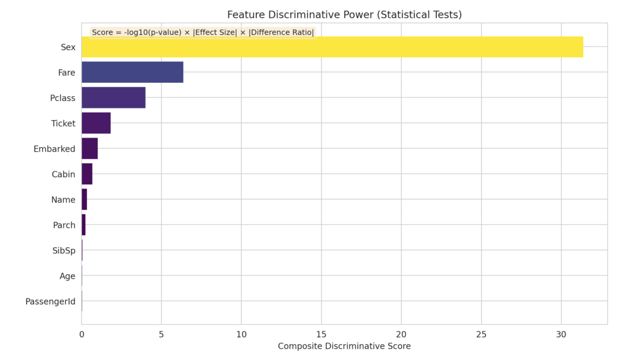
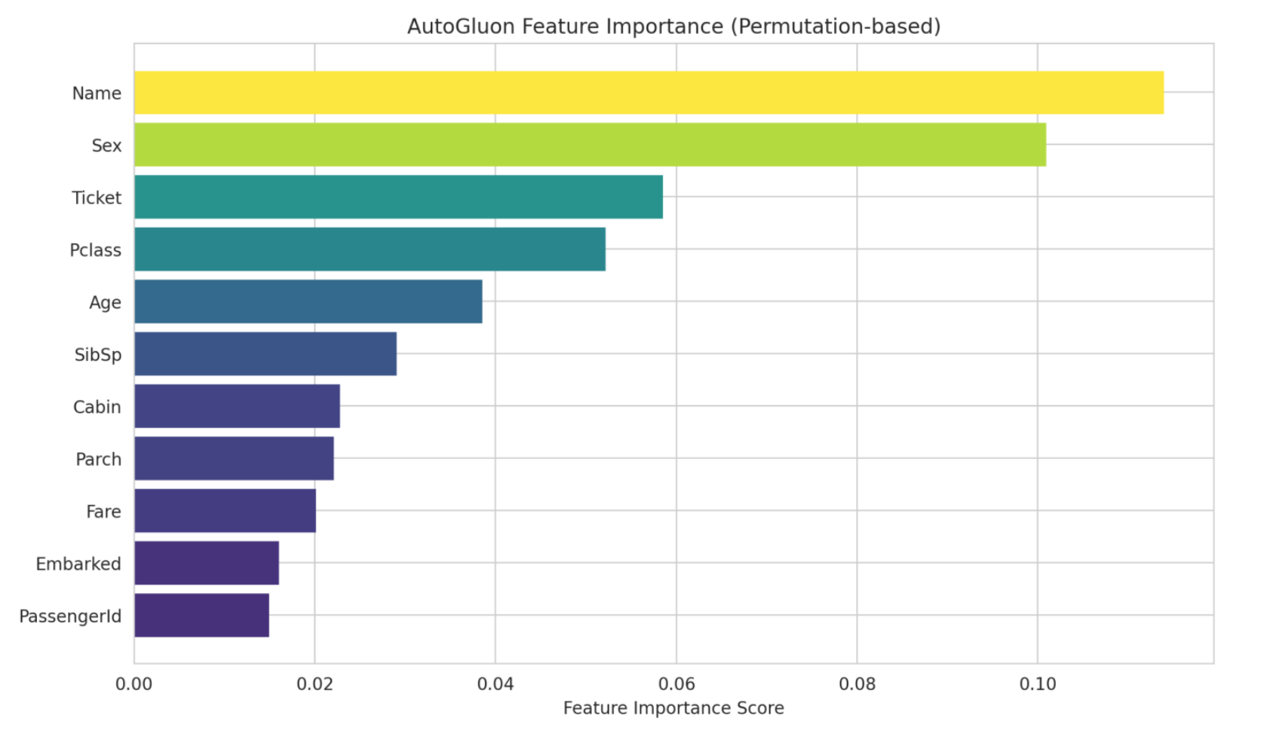
Notes:
And they are result of statistical ranking and AutoGluon ranking.In the top chart (Statistical): You can see that Sex, Fare, and Pclass have the highest scores (the longest bars). This confirms that statistically, these three factors had the biggest impact on survival.
In the bottom chart (AutoGluon): Interestingly, the Machine Learning model gives the highest score to 'Name' (the yellow bar). Why? The model picked up on titles like 'Mr.', 'Miss', or 'Master', which act as strong proxies for gender and social status.This shows that the AI found hidden value in passenger names that traditional statistics missed.

Slide 14
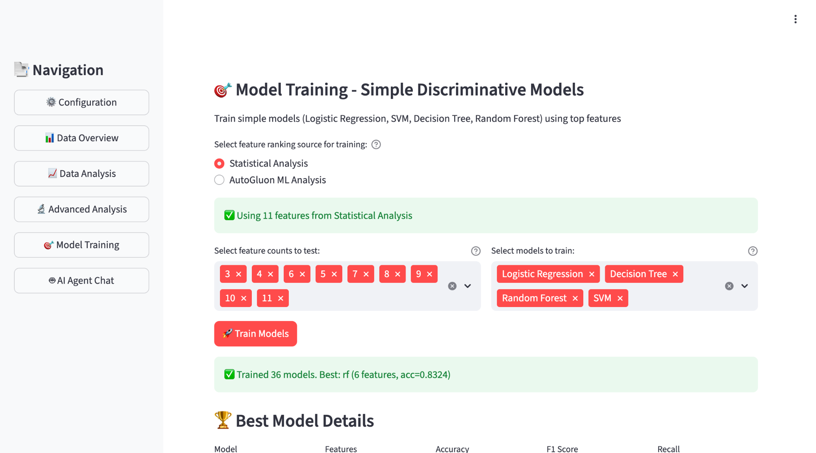
Model Training
Notes:
Model Training is where we validate our feature selection using four standard ML methods: Logistic Regression, SVM, Decision Tree, and Random Forest.
We can compare training results based on Statistical Rankings versus AutoGluon rankings with different Top-K features.

Slide 15
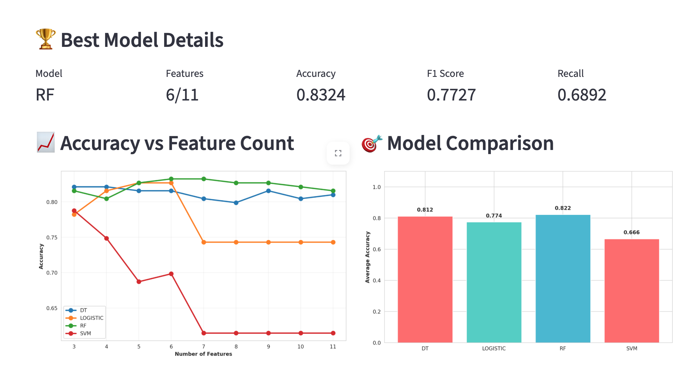
Model Training Results - Statistical
Model performance comparison: Different algorithms × Feature selection methods
Notes:
As we can see, the best model is the Random Forest with 6 features. It validates that our statistical ranking successfully identified the most 'impactful' features for the model.

Slide 16
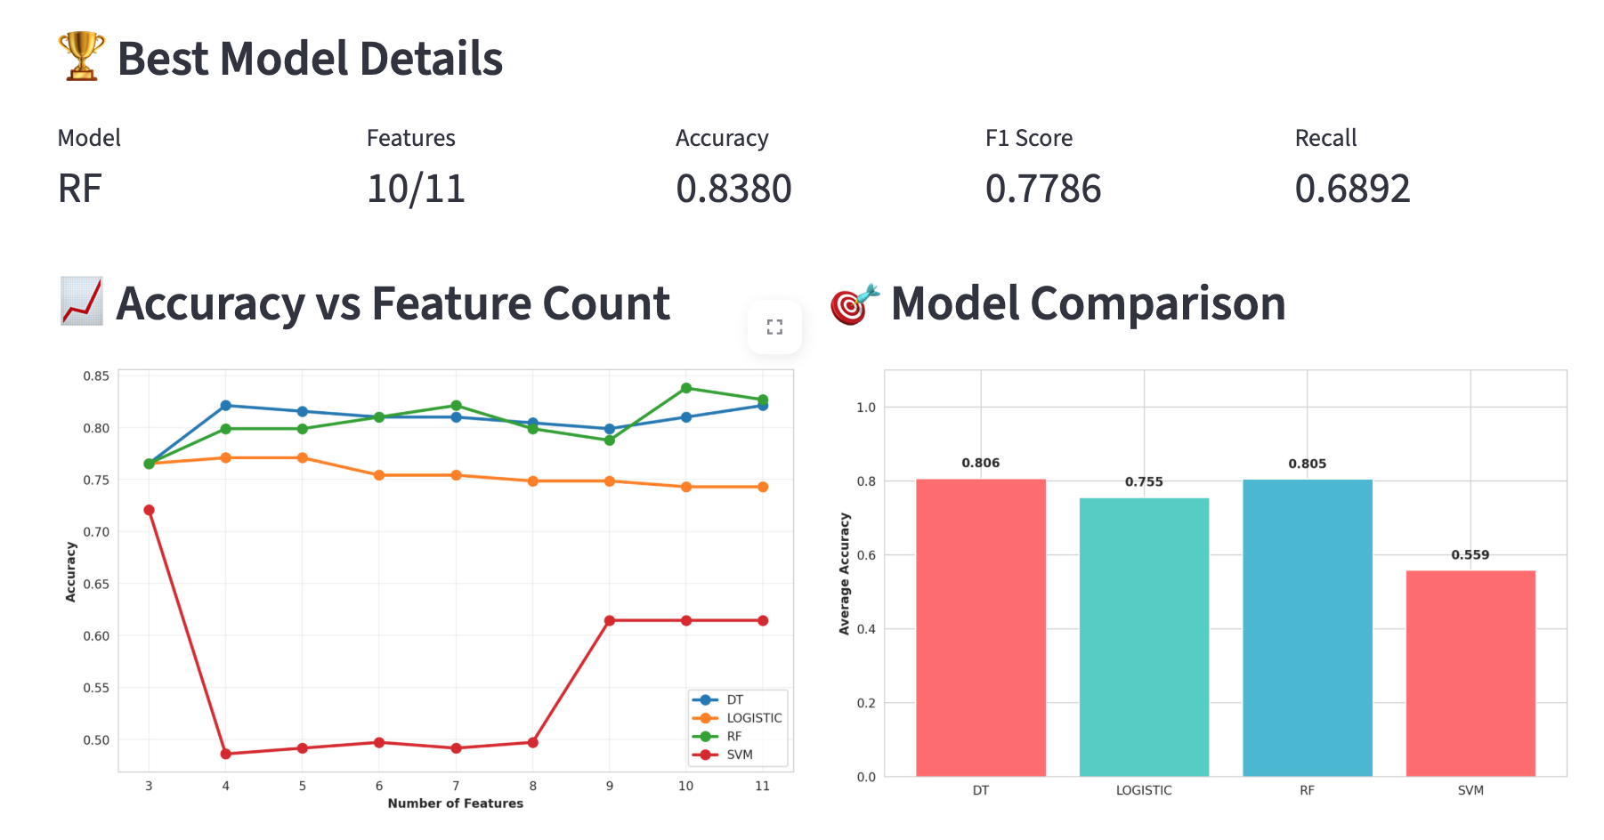
Model Training Results - AutoGluon
Model performance comparison: Different algorithms × Feature selection methods
Notes:
Looking at the AutoGluon results, it hits peak accuracy at 83.8% using 10 features.
In both cases, a smaller subset performs better than using all 11 features. This proves our ranking system successfully cuts through the noise to find the most 'impactful' features.
Now, my teammate Deng will show you how our AI Chat work.

Slide 17
AI-Powered Chat Interface: Architecture
User Natural Language Query
↓
StatisticalAgent (Intent Parser)
Rule-based + LLM Fallback (LLaMA-3)
↓
Tool Routing
Data Context
• get_feature_importance()
← Session State
• get_statistical_summary()
• processed_df
• plot_distribution()
• analysis_results
• plot_time_series()
• feature_ranking
• plot_frequency_spectrum()
• statistical_summary
↓
Response Generation: Plot + Text Summary
Notes:
In this section, I will present the implementation of our statistical AI agent.
My contribution focuses on the agent core: how it understands user requests, calls deterministic analysis and plotting tools, and returns reliable results. A key design principle is reliability. The agent never asks an LLM to compute or invent numeric results.
We use rule-based intent parsing instead of LLM guessing. All statistics and plots are generated by deterministic Python tools.
The LLM analysis is only used for fallback explanations, never for numbers.

Slide 18
LLM Backend Design
Backend | Deployment | Latency | Use Case
Ollama (LLaMA-3) | Local | 2-5s | Privacy-first deployment
OpenAI GPT-4 | Cloud | 0.5-1s | High accuracy research
Claude / Gemini | Cloud | 0.5-1s | Alternative cloud options
DeepSeek | Cloud | 1-2s | Cost-effective option
ConversationManager
Chat History
Maintains context
Context Window
Manages tokens
Session State
Links to analysis
Notes:
We use Ollama as a local runtime to run LLaMA-3 on our own machine. Ollama is a lightweight local platform that allows us to run large language models, such as LLaMA-3, directly on our machine instead of using cloud APIs. But we also provide cloud APIs as option.
On the right, the ConversationManager handles three things: maintaining chat history, managing the context window to prevent token overflow, and linking to Session State to retrieve real-time analysis results.

Slide 19
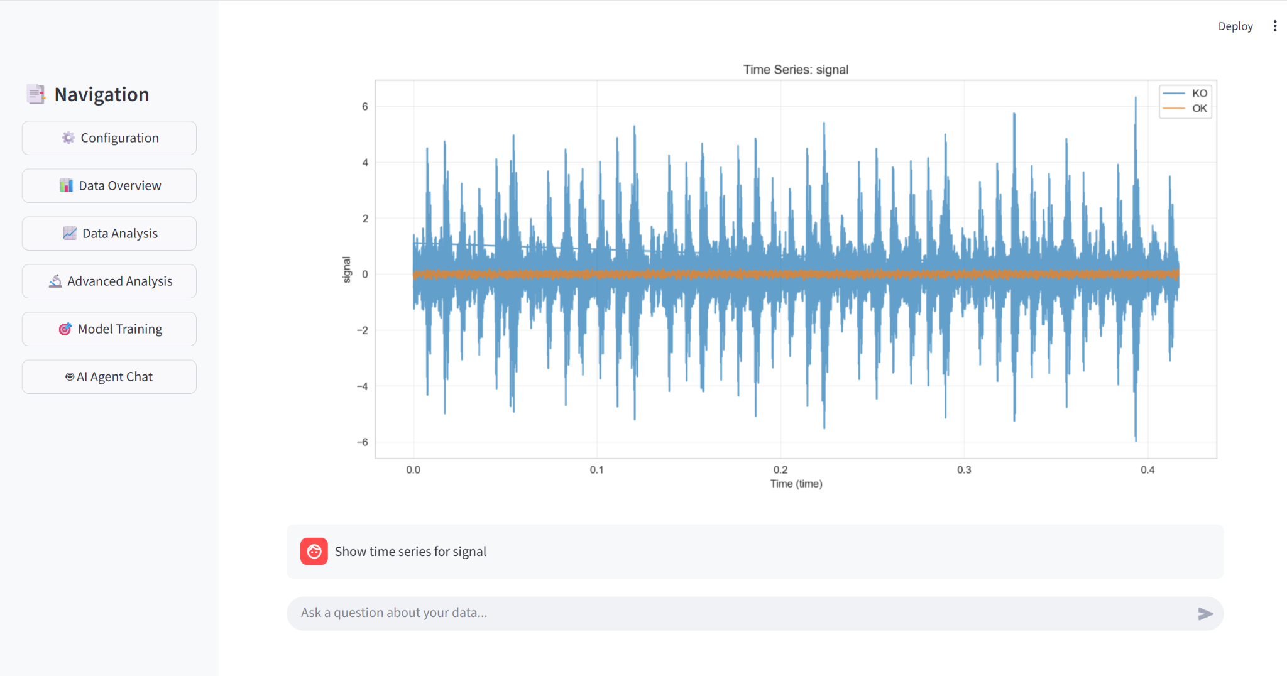
AI Agent Use Case : Time Series Visualization
User query: "Compare distribution of rms between OK and KO"
Notes:
now let’s look at the use case, we use CWRU dataset since the Titanic dataset is not suitable for plotting time series graphs and FFT graphs.
The system automatically detects the temporal characteristics of the signal column and calls the plot_time_series tool.
From the plot, we see the complete signal waveform—periodic oscillations and amplitude trends are immediately visible. This is particularly useful for industrial sensor data analysis, allowing engineers to quickly identify abnormal patterns.

Slide 20
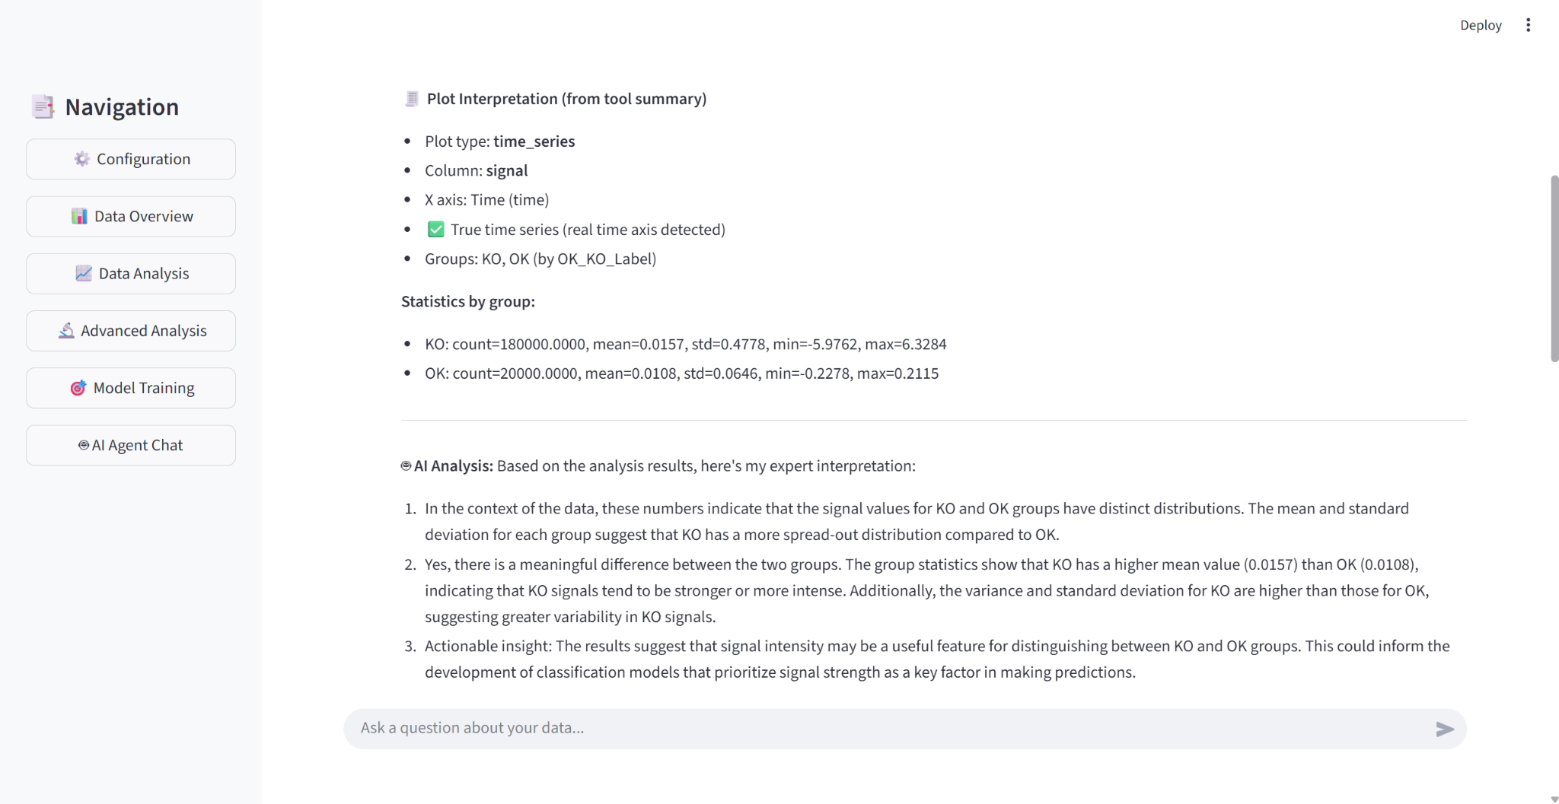
AI Agent Use Case : Time Series Visualization
User query: "Show time series of signal"
Notes:
Each plot returns both a figure and a structured summary.
The summary is used to generate explanations without hallucination.

Slide 21
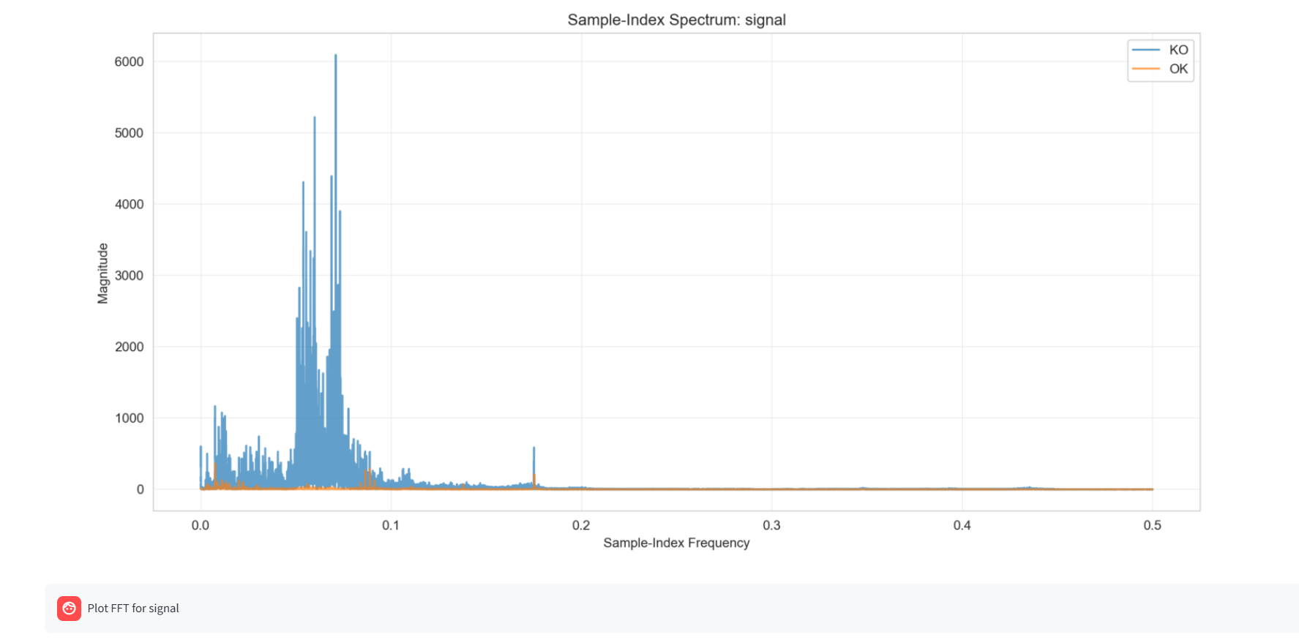
AI Agent Use Case: Frequency Spectrum (FFT)
User query: "Show frequency spectrum" - FFT with peak detection
Notes:
In this case, the agent cannot find a valid physical label, such as a sampling frequency or a real time axis.
Instead of forcing a wrong physical FFT, it switches to a simulator mode and computes a sample-index spectrum.
This means the x-axis does not represent Hertz, but sample order.

Slide 22
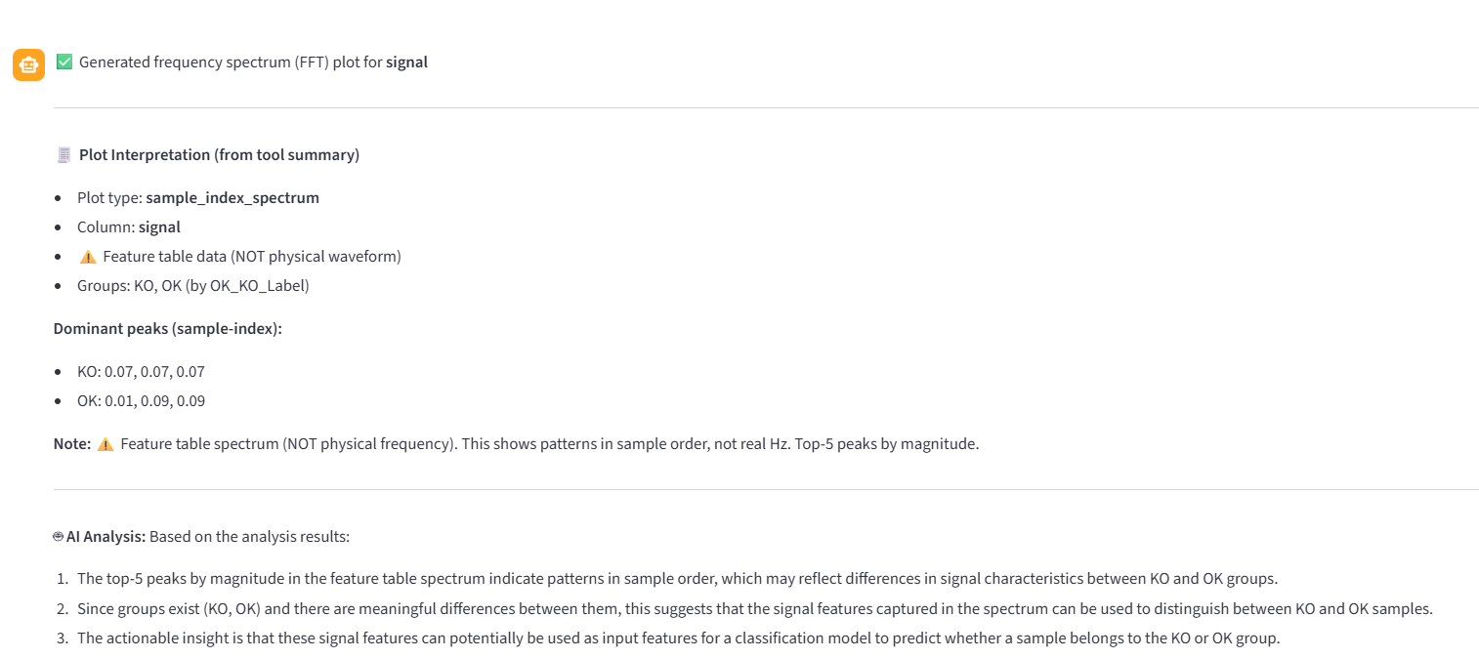
AI Agent Use Case: Frequency Spectrum (FFT)
User query: "What are the statistics for rms?" - Multi-metric view
Notes:
When physical labels or sampling information are unavailable,
the agent automatically switches to a sample-index FFT simulator.
This guarantees that frequency-domain features can still be extracted
without assuming any incorrect physical meaning.
This avoids wrong physical interpretation while preserving feature extraction.

Slide 23
AI Agent: Technical Highlights
Data Encapsulation
Robust Time Handling
No DataFrame in prompts → prevents hallucination
Auto-detects time columns with graceful fallback
Context-Aware
Flexible Visualization
Receives full analysis results for comprehensive queries
Natural language → plot type selection automatically
Structured Output Pattern
Plot + Summary + AI Interpretation → Deterministic computation (no AI guessing)
Notes:
Let me summarize the four technical highlights of our AI Agent:
1. Data Encapsulation: The DataFrame never enters the prompt. Only pass structured summaries; never pass raw DataFrames.
2. Robust Time Handling: Automatically detects time columns, supports multiple formats, and gracefully degrades to index on failure.
3. Context-Aware: The AI receives complete analysis_results, so it understands references like 'that feature from before' or 'the previous result.'
4. Flexible Visualization: When users say 'compare,' it draws histograms; 'trend' triggers line plots; 'correlation' creates scatter plots—automatic mapping from natural language to chart types.

Slide 24
System Design Philosophy
1
2
3
Parallel Validation
Shared State
Anti-Hallucination
Statistical + ML methods
run independently
→ user selects best
One analysis
→ multiple consumers
No duplication
Tool-based execution
→ deterministic results
No AI guessing
Notes:
"Finally, let me summarize the system's design philosophy with three pillars:
First Pillar: Parallel Validation Statistical methods and machine learning methods run independently without interference. After seeing both ranking results, users select the most appropriate one based on their specific scenario. This avoids the bias of 'trusting only one method.'
Second Pillar: Shared State One analysis, multiple consumers. Model training uses these results, and AI chat also uses these results. No duplicate computation, no risk of data inconsistency.
Third Pillar: Anti-Hallucination Tool-based execution mechanism means the AI can only call predefined functions and cannot fabricate numbers. All computations are deterministic with no room for AI guessing.
These three pillars jointly ensure the system's scientific rigor, efficiency, and trustworthiness."

Slide 25
Thank You
Key Contributions
✓ Parallel-validation architecture for feature ranking
✓ Multi-backend LLM integration with local deployment
✓ Context-aware AI agent with anti-hallucination design
✓ Interactive visualization toolkit for exploratory analysis
Lei GAO (s327756) • Lan DENG (s338219)

